Slide 1
MIS 321
Design Patterns

Slide 2

Criminal Minds
https://www.youtube.com/watch?v=WToUQ5aT1uA

Slide 3
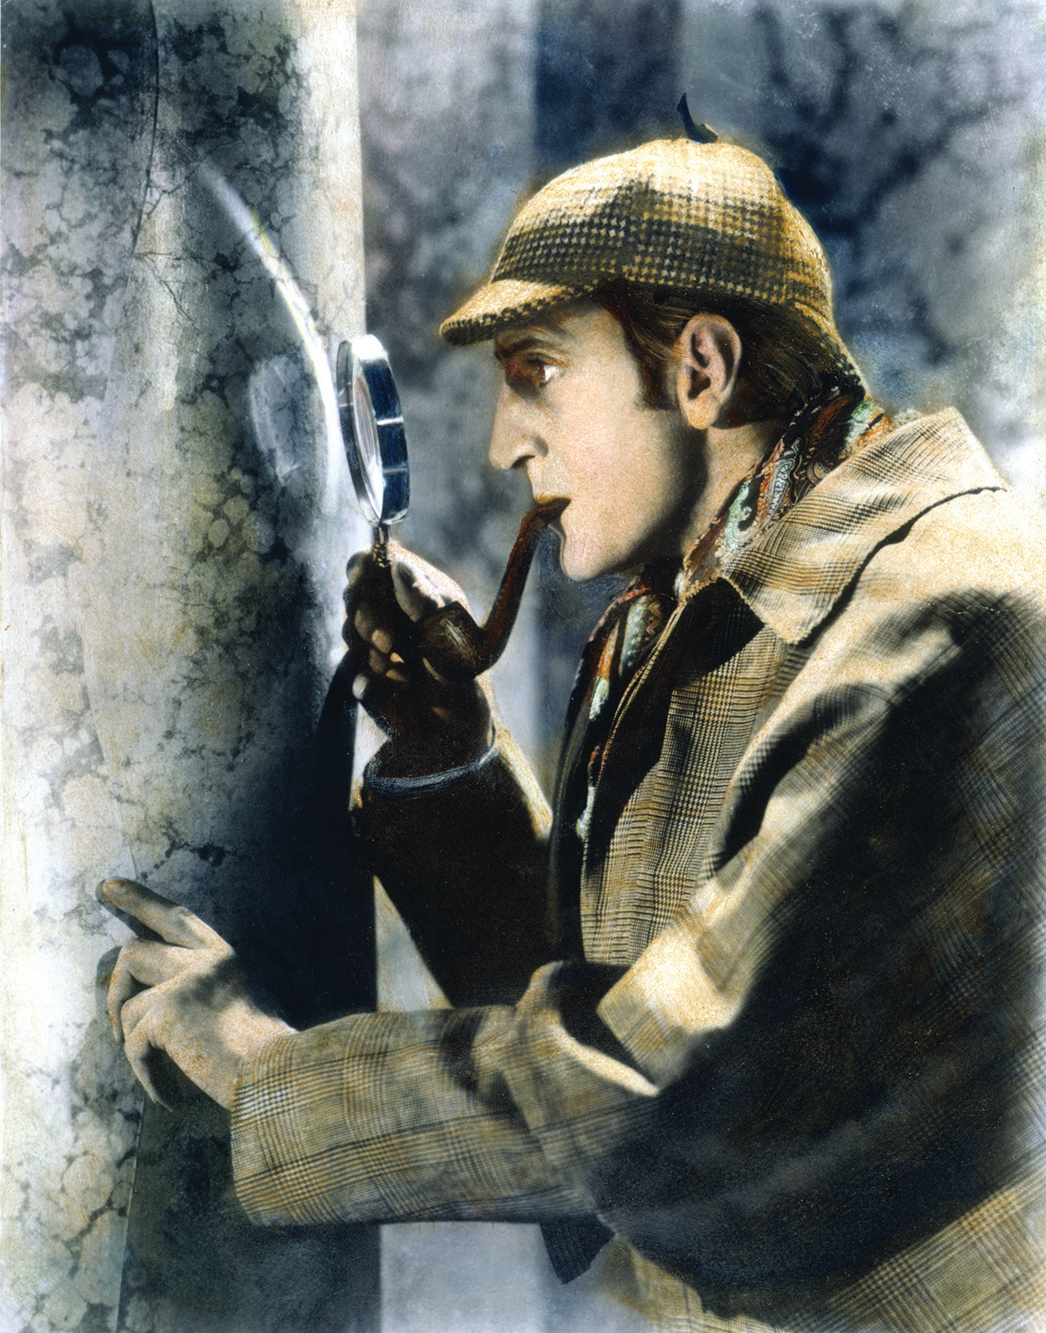
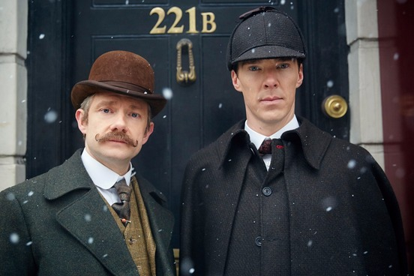
What are Design Patterns

Slide 4
What are Design Patterns
There have only been 7 stories (plot structures) ever told
Overcoming the monster
Rags to riches
The quest
Voyage and return
Rebirth
Comedy
Tragedy

Slide 5
What are Design Patterns
What does this have to do with Business Programming II?
In all likelihood, “someone has already solved your problem”.

Slide 6

What are Design Patterns
The term design pattern was originally used by Christopher Alexander to describe building architecture, but has seen many applications since.
Problem : Highway crossings
Pattern: Clover leaf

Slide 7
What are Design Patterns
“Each pattern describes a problem which occurs over and over again in our environment, and then describes the core of the solution to that problem…..” – Christopher Alexander

Slide 8
Why Learn Design Patterns
Tried and proven solutions
Provides a starting point
Provides known tradeoffs
Easier to alter than create from scratch
Provides common vocabulary
Similar to mythologies, it provides a way to speak to each other
i.e. “We could use the observer pattern” is a lot easier than describing the potential solution every time you think it should be used
Gets us out of the weeds early in the design process

Slide 9
Why Learn Design Patterns
Helps ensure adherence to design principles when appropriate
Improves understanding of OO principles
Less conceptual… easier to understand looking at actual design
Broadly understand patterns makes maintenance easier

Slide 10

“Gang of Four” (GoF) Design Patterns
Design Patterns: Elements of Reusable Object-Oriented Software
Published in 1994
Dr. Erich Gamma
Dr. Richard Helm
Dr. Ralph Johnson
Dr. John Vlissides

Slide 11
4 Essential Elements of Design Patterns
Name: Identifies a pattern
Problem: describes when to apply the pattern in terms of the problem and the context
Solutions: describes elements that make up the design, their relationships, responsibilities, and collaborations.
Consequences: results and trade-offs of applying the pattern

Slide 12
GoF Patterns
Creational Patterns (5)
Deals with initializing and configuring classes and objects
Structural Patterns (7)
Deals with decoupling interface and implementation of classes and objects
Behavioral Patterns (11)
Deals with dynamic interactions among societies of classes and objects (i.e. how they distribute responsibilities)

Slide 13
Questions

